Slide 1
Predicting Crash Severity
Coursera Capstone Project

Slide 2
Introduction
Motivation
Traffic accidents are severe concern for most of the countries
Approx. 1.25 million people deaths caused because of road accident injuries in a year
Complexity of dataset
Objective
To help traffic control authorities predict the accident severity
Effectively able to predict “Serious” accidents

Slide 3
Dataset
Size of Dataset: ~1.3 GB
Number of records: ~ 3.5 Million rows
Number of columns: 49 Columns
Source: https://www.kaggle.com/sobhanmoosavi/us-accidents

Slide 4
Data Pre-processing
Records with missing values were dropped from the calculation Categorical data labelled with numerical values
Some outliers, especially with extremely short or long time to clear the accident, were processed and replaced with median values

Slide 5
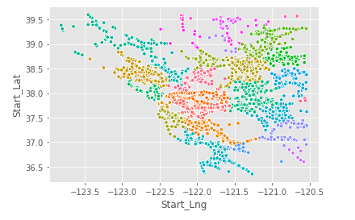
Data Visualization

Slide 6
Algorithms Used
K- Nearest Neighbor
Random Forest
Decision Trees
SVM
Logistic Regression

Slide 7
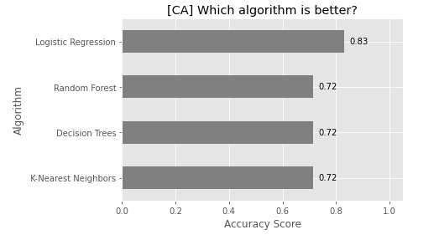
Comparative Analysis

Slide 8
Conclusion
In conclusion, Random Forest algorithm is the winner and KNN is the last on the list in terms of accuracy.
Prediction accuracy can be further improved by removing less important or irrelevant features.

